Slide 1

Styling Made Awesome
Presenter:
Daniel McCarthy
Date:
10/16/2019

Slide 2

Initial release: 1996
Current version: CSS 3 (2017)
Doesn’t support logic
Pseudo selectors such as :nth-child(n)

Slide 3
Grid

Slide 4


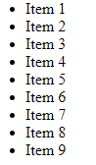
Browser(s):
CSS:

Slide 5

Browser(s):
CSS: | .grid-container { display: grid; grid-template-columns: repeat(3, 1fr); }

Slide 6
Browser(s):
CSS: | .grid-container { display: grid; grid-template-columns: repeat(3, 1fr); }

Slide 7

Browser(s):
CSS: | .grid-container { /* IE grid support */ display: -ms-grid; /* cannot utilize the repeat function */ -ms-grid-columns: 1fr 1fr 1fr; display: grid; grid-template-columns: repeat(3, 1fr); }

Slide 8

Browser(s):
CSS: | .grid-container > li:nth-child(3n + 1) { -ms-grid-column: 1; } .grid-container > li:nth-child(3n + 2) { -ms-grid-column: 2; } .grid-container > li:nth-child(3n) { -ms-grid-column: 3; }

Slide 9

Browser(s):
CSS: | .grid-container > li:nth-child(n - 4) { -ms-grid-row: 1; } .grid-container > li:nth-child(n + 4) { -ms-grid-row: 2; } .grid-container > li:nth-child(n + 7) { -ms-grid-row: 3; }

Slide 10
Browser(s):
CSS: | .grid-container { /* IE grid support */ display: -ms-grid; /* cannot utilize the repeat function */ -ms-grid-columns: 1fr 1fr 1fr; display: grid; grid-template-columns: repeat(3, 1fr); } | .grid-container > li:nth-child(3n + 1) { -ms-grid-column: 1; } .grid-container > li:nth-child(3n + 2) { -ms-grid-column: 2; } .grid-container > li:nth-child(3n) { -ms-grid-column: 3; } | .grid-container > li:nth-child(n - 4) { -ms-grid-row: 1; } .grid-container > li:nth-child(n + 4) { -ms-grid-row: 2; } .grid-container > li:nth-child(n + 7) { -ms-grid-row: 3; }

Slide 11
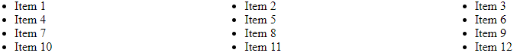

Browser(s):
Browser(s):

Slide 12
“Syntactically Awesome Style Sheets”
Mitigates complex, lengthy and unmanageable CSS
An extension to CSS
Gets compiled back into CSS
Indented syntax

Slide 13
selector1 style: value selector2 style: value | selector1 { style: value; } selector2 { style: value; }

Slide 14
SCSS (no logo so they get comic sans)
“Sassy CSS”
Syntax of
All the features of

Slide 15
SCSS
selector1 {
style: value;
}
selector2 {
style: value;
}

Slide 16
Mixins

Slide 17
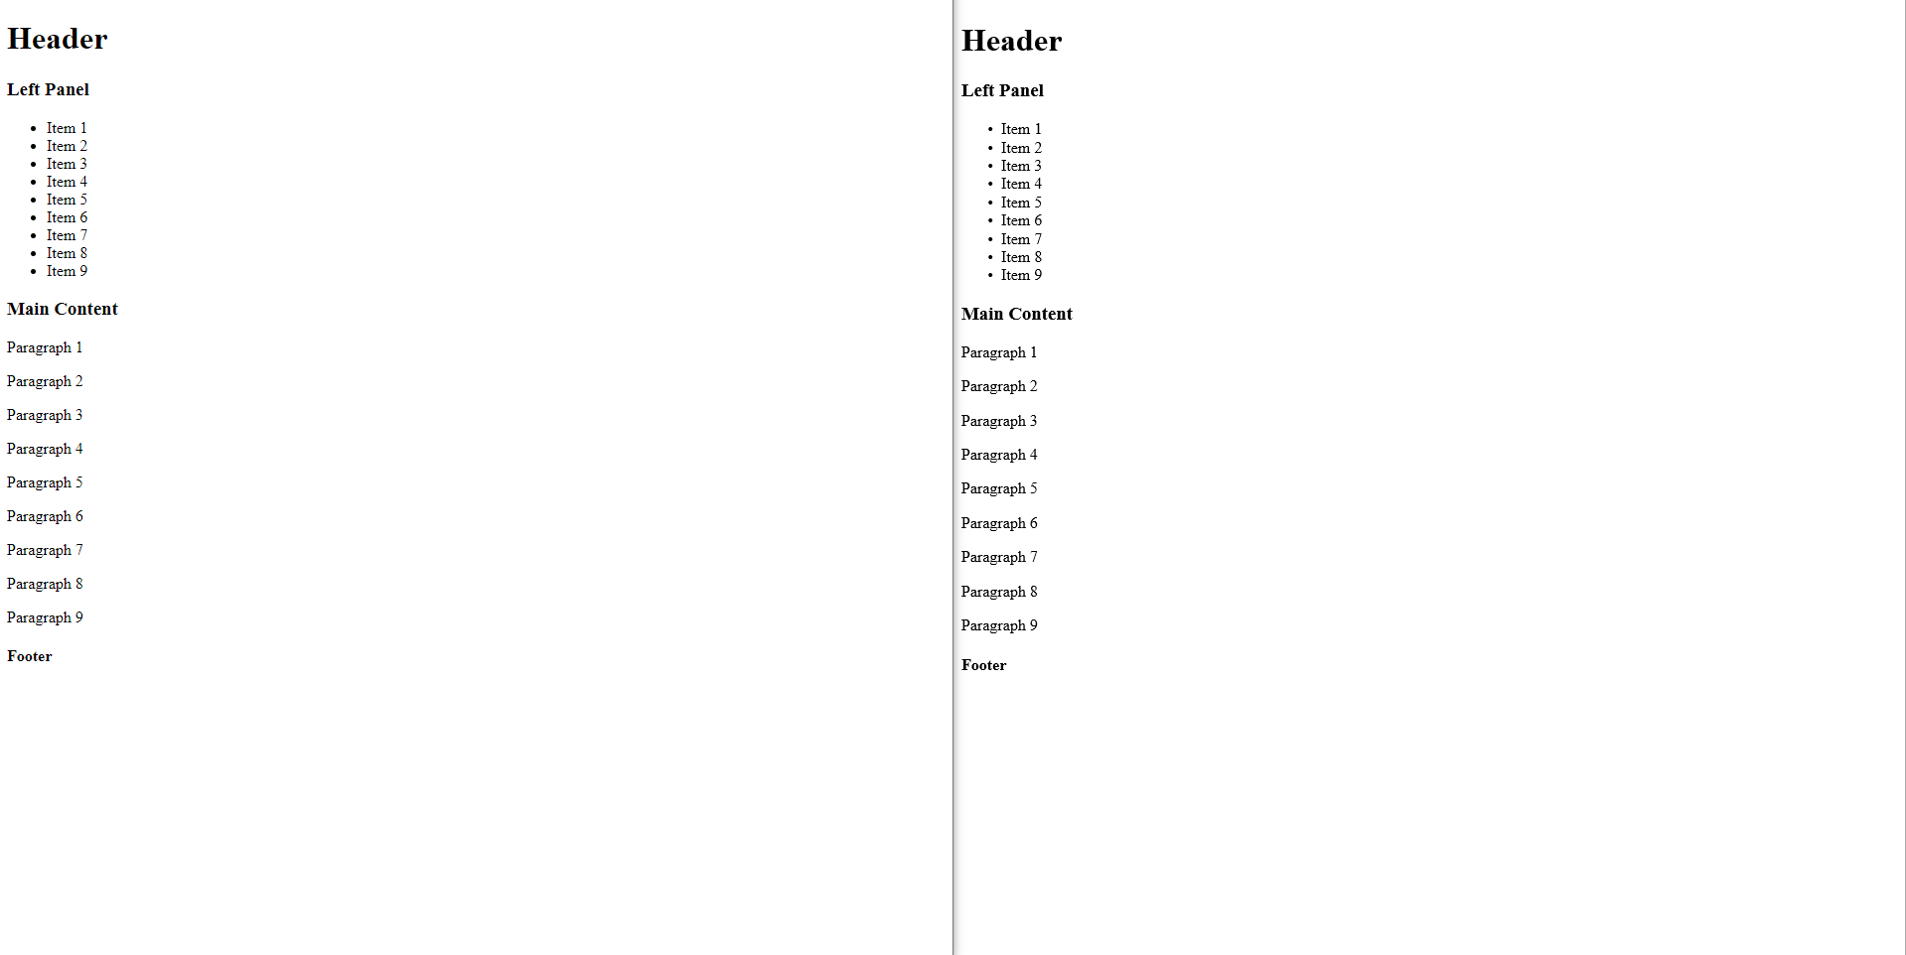

Slide 18
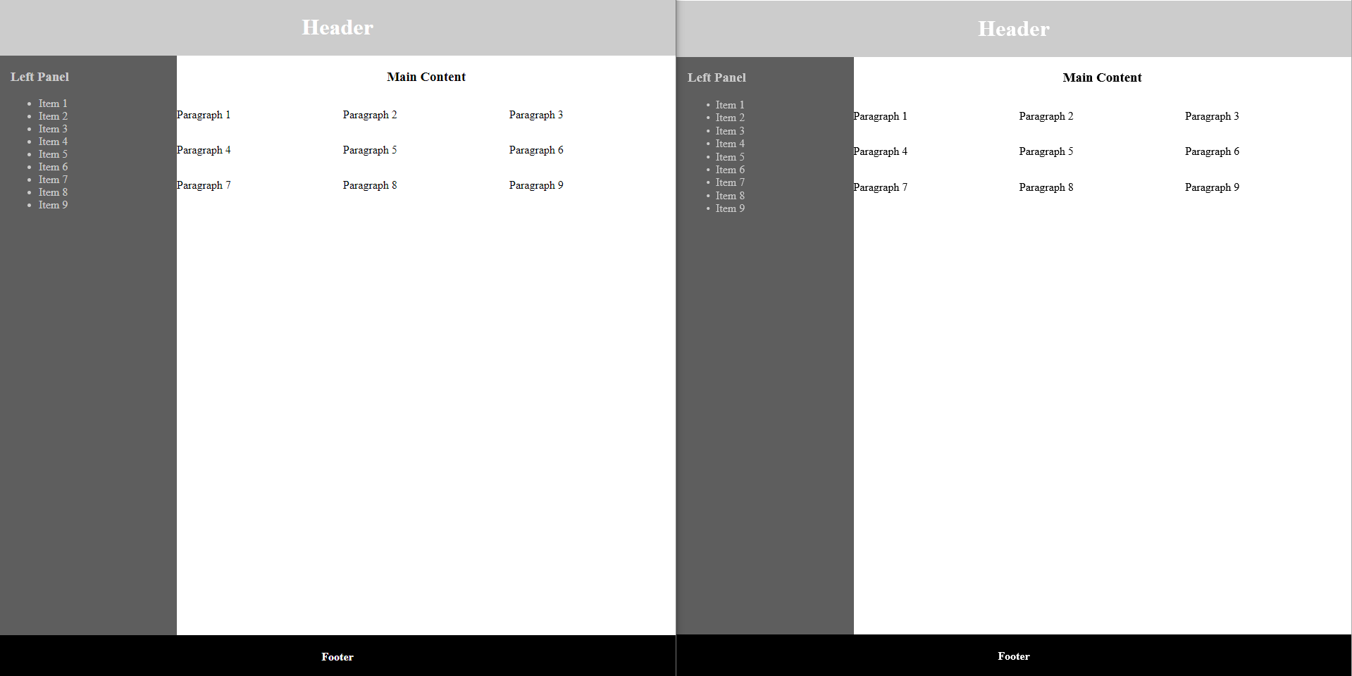

Slide 19
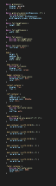
SCSS

Slide 20
SCSS
@mixin text-center-mixin { text-align: center; } @mixin grid-mixin { display: -ms-grid; display: grid; } @mixin grid-cols-mixin($colDimensions: 1fr) { @include grid-mixin; -ms-grid-columns: $colDimensions; grid-template-columns: $colDimensions; } | @mixin full-height-mixin { height: 100%; } @mixin full-width-mixin { width: 100%; } @mixin full-mixin { @include full-height-mixin; @include full-width-mixin; }

Slide 21
SCSS
@mixin full-height-mixin { height: 100%; } @mixin full-width-mixin { width: 100%; } @mixin full-mixin { @include full-height-mixin; @include full-width-mixin; } .body-container { @include full-mixin; display: flex; flex-direction: column; } | .body-container { height: 100%; width: 100%; display: flex; flex-direction: column; }

Slide 22
SCSS
@mixin grid-mixin { display: -ms-grid; display: grid; } @mixin grid-cols-mixin($colDimensions: 1fr) { @include grid-mixin; -ms-grid-columns: $colDimensions; grid-template-columns: $colDimensions; } .main-container { @include grid-cols-mixin(1fr 1fr 1fr); text-align: left; } | .main-container { display: -ms-grid; display: grid; -ms-grid-columns: 1fr 1fr 1fr; grid-template-columns: 1fr 1fr 1fr; text-align: left; }

Slide 23
Mixins
Declared at the top of your SCSS
Used to make CSS reusable
Only create a mixin when CSS needs to be reused

Slide 24
Nested Selectors

Slide 25
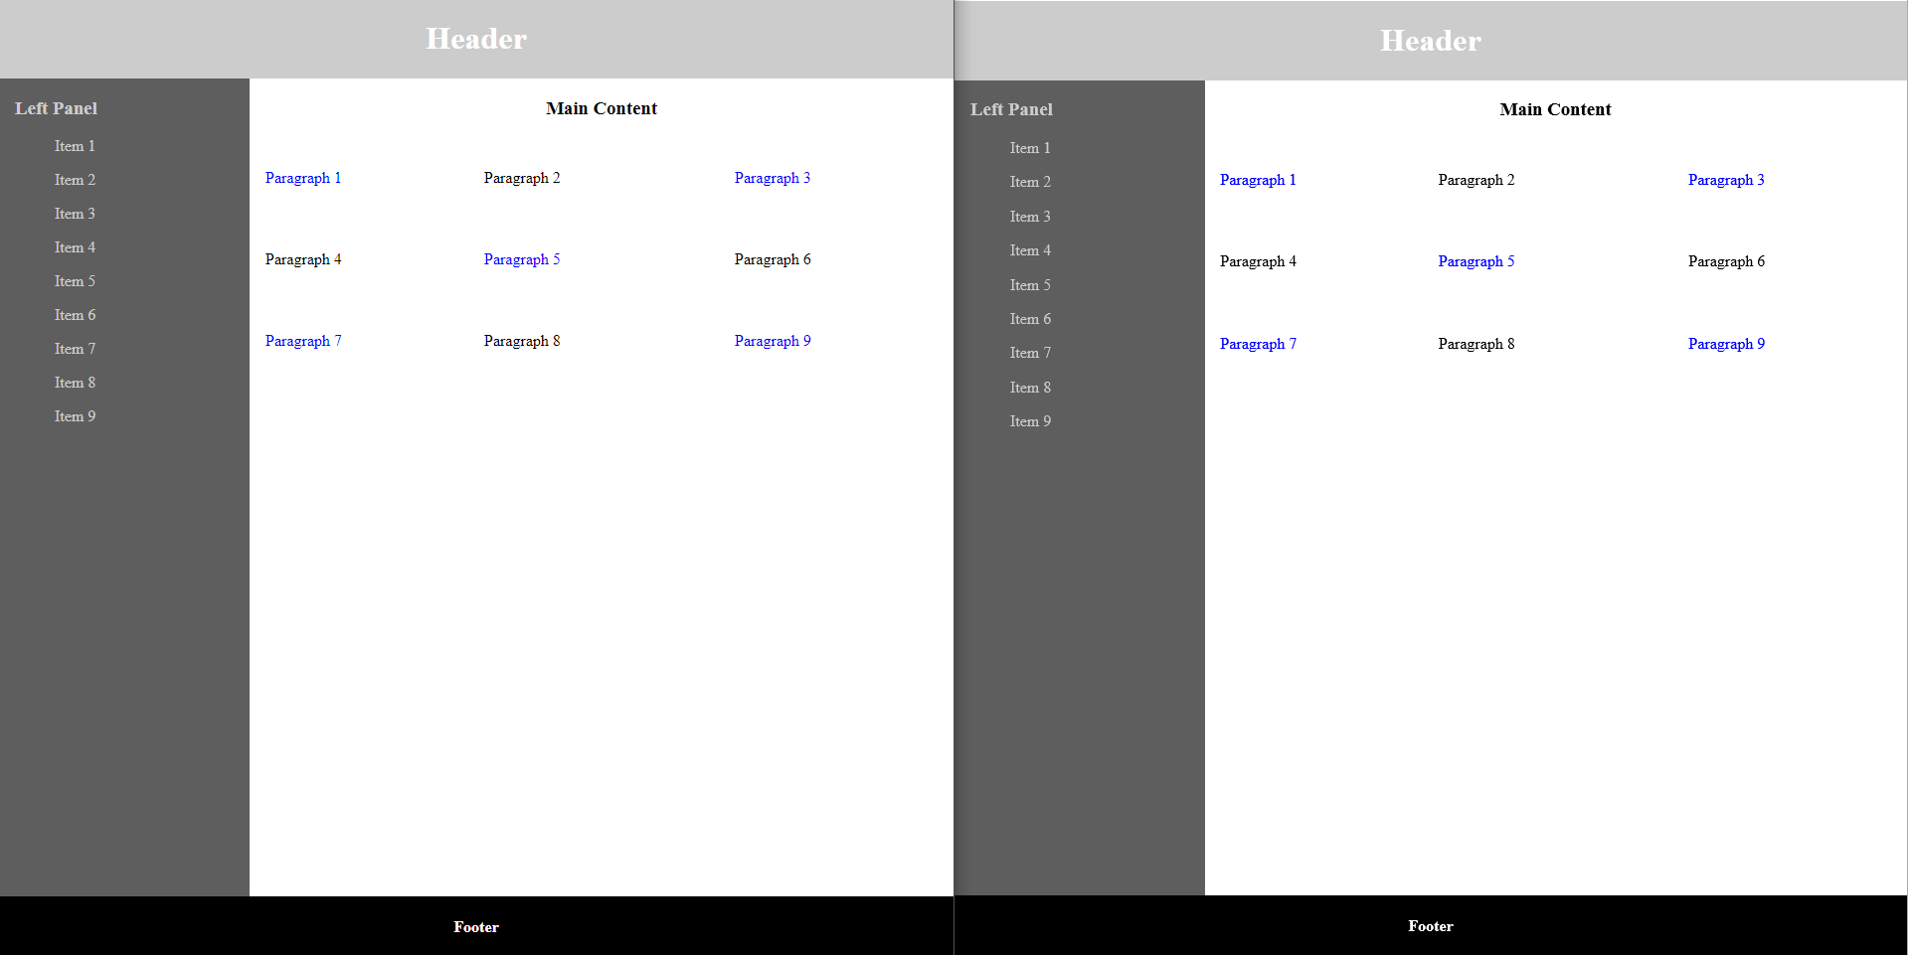

Slide 26
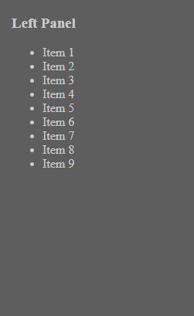
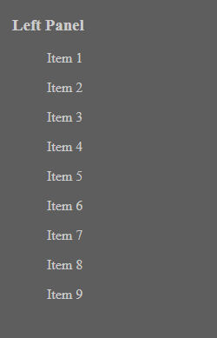
SCSS
.left-container {
flex: 1;
padding-left: 1rem;
background-color: #5e5e5e;
color: #ccc;
> ul {
list-style-type: none;
> li {
margin-bottom: 1rem;
}
}
}
Before | After

Slide 27
SCSS
.left-container { flex: 1; padding-left: 1rem; background-color: #5e5e5e; color: #ccc; > ul { list-style-type: none; > li { margin-bottom: 1rem; } } } | .left-container { flex: 1; padding-left: 1rem; background-color: #5e5e5e; color: #ccc; } .left-container > ul { list-style-type: none; } .left-container > ul > li { margin-bottom: 1rem; }

Slide 29
SCSS
.main-container { @include grid-cols-mixin(1fr 1fr 1fr); text-align: left; > p { padding: 1rem; } > p:nth-child(odd) { color: blue; } > p:nth-child(3n + 2) { padding: 1rem 0; } > p:nth-child(3n + 1) { -ms-grid-column: 1; } | > p:nth-child(3n + 2) { -ms-grid-column: 2; } > p:nth-child(3n) { -ms-grid-column: 3; } > p:nth-child(n - 4) { -ms-grid-row: 1; } > p:nth-child(n + 4) { -ms-grid-row: 2; } > p:nth-child(n + 7) { -ms-grid-row: 3; } }

Slide 30
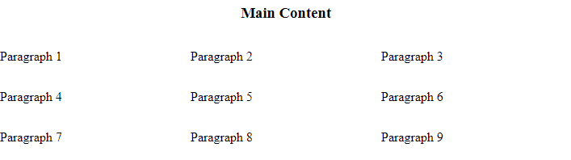
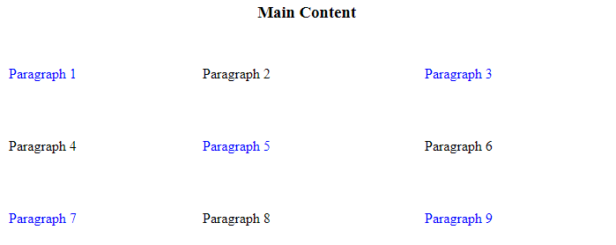
SCSS
Before
> p {
padding: 1rem;
}
> p:nth-child(odd) {
color: blue;
}
> p:nth-child(3n + 2) {
padding: 1rem 0;
}
After

Slide 31
Nested Selectors
Use the most specific selector(s) possible
Do not nest selectors more than 3 layers deep
Make sure nested selectors are the best solution

Slide 32
Variables

Slide 33
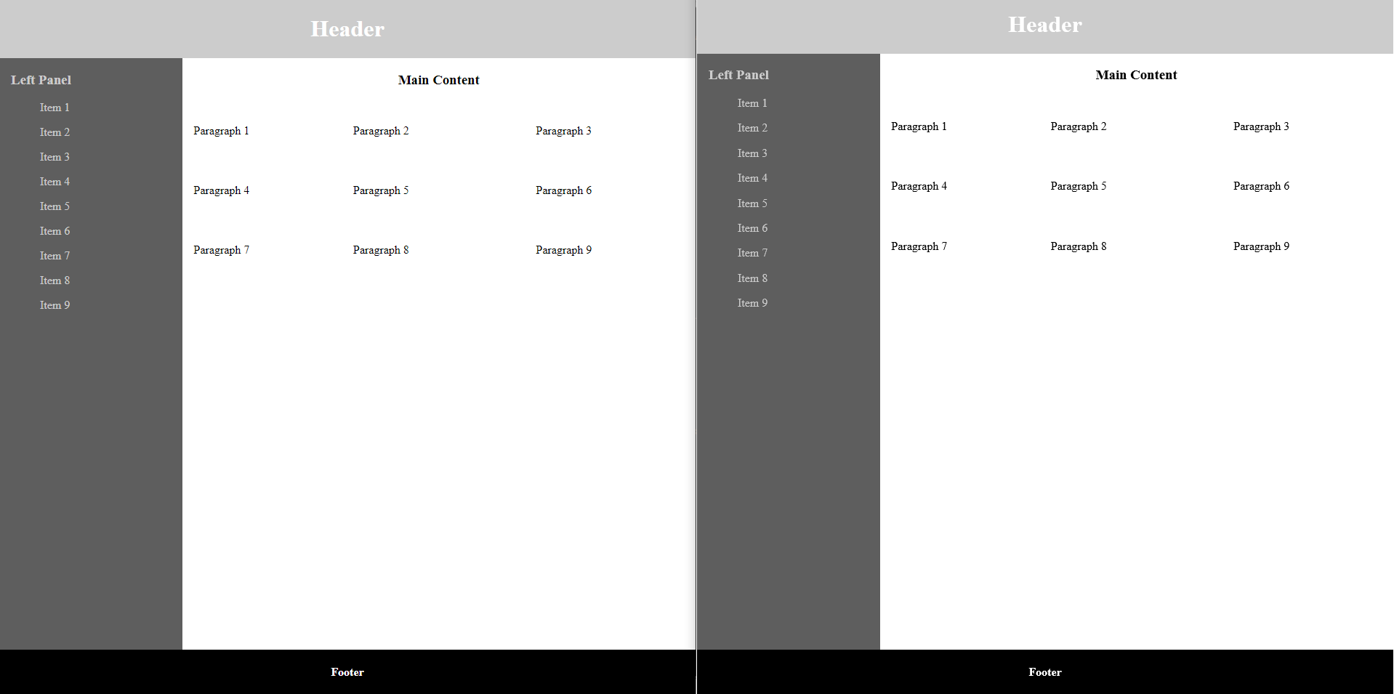

Slide 34
SCSS
$white: #fff; $black: #000; $light-grey: #ccc; $dark-grey: #5e5e5e; $primary-font-color: $white; $secondary-font-color: $light-grey; $primary-background-color: $light-grey; $secondary-background-color: $dark-grey; $tertiary-background-color: $black; | $margin-size: 1rem; $padding-size: 1rem;

Slide 35
SCSS
@import './variables.scss’; | @mixin white-text-mixin { color: $primary-font-color; } | .left-container { flex: 1; padding-left: $padding-size; background-color: $secondary-background-color; color: $secondary-font-color; ul { list-style-type: none; li { margin-bottom: $margin-size; } } }

Slide 36
SCSS
.left-container { flex: 1; padding-left: $padding-size; background-color: $secondary-background-color; color: $secondary-font-color; ul { list-style-type: none; li { margin-bottom: $margin-size; } } } | .left-container { flex: 1; padding-left: 1rem; background-color: #5e5e5e; color: #ccc; } .left-container > ul { list-style-type: none; } .left-container > ul > li { margin-bottom: 1rem; }
$light-grey: #ccc; $dark-grey: #5e5e5e; $secondary-font-color: $light-grey; $secondary-background-color: $dark-grey; | $margin-size: 1rem; $padding-size: 1rem;

Slide 37
SCSS
$primary-font-color: red;
$secondary-font-color: orange;
$primary-background-color: yellow;
$secondary-background-color: green;
$tertiary-background-color: blue;

Slide 38
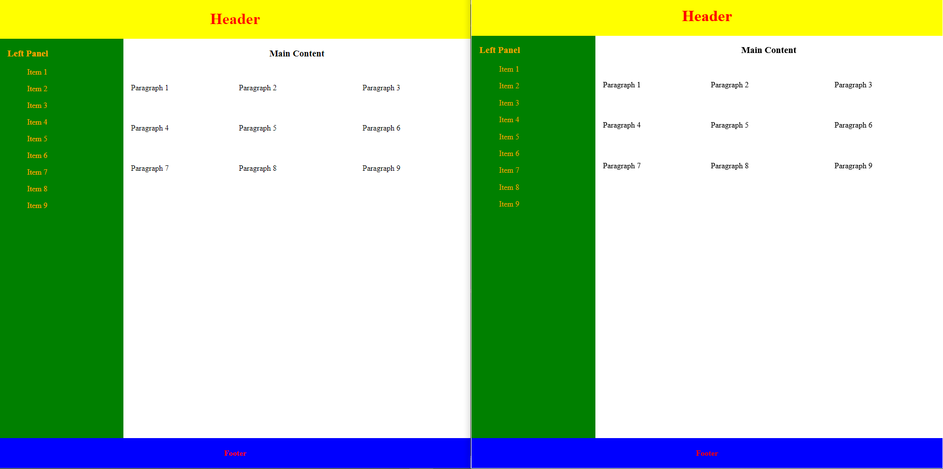

Slide 39
Variables
Declared in separate, specific SCSS files
Can quickly change the look and feel of your app
Makes maintenance far easier

Slide 40
Inheritance

Slide 41
Inheritance
Poorly implemented and documented
Can tightly or weakly couple styles to elements
Commonly misused
Inferior to mixins

Slide 42
Functions

Slide 43
1
1
2
3
2
4
5
6
3
7
8
9
…
33
97
98
99
34
100

Slide 44
.grid-container > li:nth-child(3n + 1) { -ms-grid-column: 1; } .grid-container > li:nth-child(3n + 2) { -ms-grid-column: 2; } .grid-container > li:nth-child(3n) { -ms-grid-column: 3; } | .grid-container > li:nth-child(n - 4) { -ms-grid-row: 1; } .grid-container > li:nth-child(n + 4) { -ms-grid-row: 2; } .grid-container > li:nth-child(n + 7) { -ms-grid-row: 3; } … .grid-container > li:nth-child(n + 97) { -ms-grid-row: 33; } .grid-container > li:nth-child(n + 100) { -ms-grid-row: 34; }

Slide 45
.grid-container > li:nth-child(4n + 1) { -ms-grid-column: 1; } .grid-container > li:nth-child(4n + 2) { -ms-grid-column: 2; } .grid-container > li:nth-child(4n + 3) { -ms-grid-column: 3; } .grid-container > li:nth-child(4n) { -ms-grid-column: 4; } | .grid-container > li:nth-child(n - 5) { -ms-grid-row: 1; } .grid-container > li:nth-child(n + 5) { -ms-grid-row: 2; } .grid-container > li:nth-child(n + 9) { -ms-grid-row: 3; } … .grid-container > li:nth-child(n + 93) { -ms-grid-row: 24; } .grid-container > li:nth-child(n + 97) { -ms-grid-row: 25; }

Slide 46
SCSS
@function pow($base, $exponent) { $result: 1; @for $_ from 1 through $exponent { $result: $result * $base; } @return $result; } .sidebar { float: left; margin-left: pow(4, 3) * 1px; } | .sidebar { float: left; margin-left: 64px; }

Slide 47
SCSS
@function invert($color, $amount: 100%) { $inverse: change-color($color, $hue: hue($color) + 180); @return mix($inverse, $color, $amount); } $primary-color: #036; .header { background-color: invert($primary-color, 80%); } | .header { background-color: #523314; }

Slide 48
SCSS
Equality | Relational | Numeric | String | Boolean
== | > | + | "Helvetica" + " Neue"; // "Helvetica Neue" | true
!= | >= | - | sans- + serif; // sans-serif | false
 | < | * | {10px + 5px} / 30px; // 15px/30px
 | <= | / | sans - serif; // sans-serif
 |  | %

Slide 49
SCSS
@mixin IE-grid-cols-mixin($cols: 3) {
@debug "creating col class: #{$cols} for grid-#{$cols}";
> *:nth-child(#{$cols}n) {
-ms-grid-column: $cols;
}
@for $i from 1 to $cols {
@debug "creating col class: #{$i} for grid-#{$cols}";
> *:nth-child(#{$cols}n + #{$i}) {
-ms-grid-column: $i;
}
}
}
styles.scss:15 Debug: creating col class: 1 for grid-3
styles.scss:15 Debug: creating col class: 2 for grid-3
styles.scss:9 Debug: creating col class: 3 for grid-3
.grid-3-col > *:nth-child(3n) {
-ms-grid-column: 3;
}
.grid-3-col > *:nth-child(3n+1) {
-ms-grid-column: 1;
}
.grid-3-col > *:nth-child(3n+2) {
-ms-grid-column: 2;
}

Slide 50
SCSS
@mixin IE-grid-rows-mixin($cols: 3, $rows: 3) {
// any item less than the number of cols
@debug "creating row class: 1 for grid-#{$cols}";
> *:nth-child(n - #{$cols + 1}) {
-ms-grid-row: 1;
}
@for $i from 1 to $rows {
@debug "creating row class: #{($i + 1)} for grid-#{$cols}";
> *:nth-child(n + #{($cols + 1) + ($cols * ($i - 1))}) {
-ms-grid-row: $i + 1;
}
}
}
styles.scss:30 Debug: creating row class: 2 for grid-3
styles.scss:30 Debug: creating row class: 3 for grid-3
styles.scss:24 Debug: creating row class: 1 for grid-3
.grid-3-col > *:nth-child(n-4) {
-ms-grid-row: 1;
}
.grid-container > li:nth-child(n + 4) { -ms-grid-row: 2; } .grid-container > li:nth-child(n + 7) { -ms-grid-row: 3; }

Slide 51
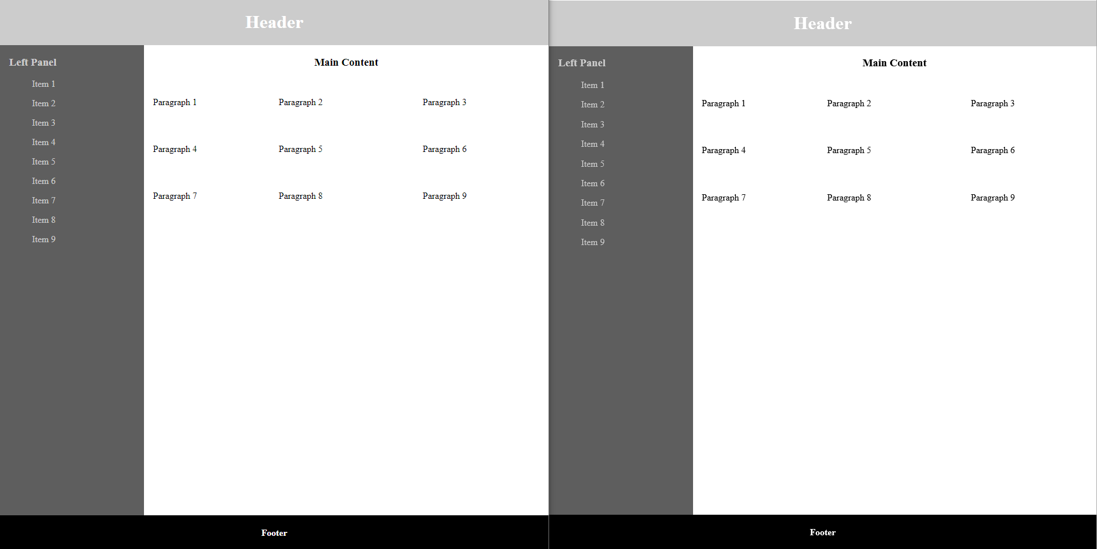

Slide 52
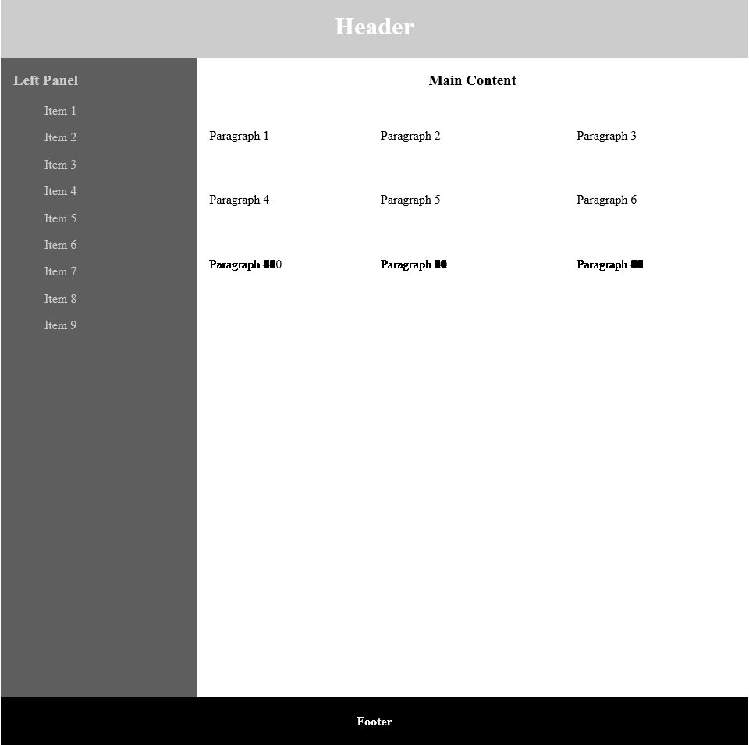

Slide 53
SCSS
@mixin grid-mixin { display: -ms-grid; display: grid; } @mixin grid-cols-mixin($colDimensions: 1fr, $cols: 3, $rows: 3) { @include grid-mixin; -ms-grid-columns: $colDimensions; grid-template-columns: $colDimensions; @include IE-grid-cols-mixin($cols); @include IE-grid-rows-mixin($cols, $rows); } .grid-3-col { @include grid-cols-mixin(1fr 1fr 1fr, 3, 34); }
.grid-3-col {
display: -ms-grid;
display: grid;
-ms-grid-columns: 1fr 1fr 1fr;
grid-template-columns: 1fr 1fr 1fr;
}
.grid-3-col > *:nth-child(n-4) {
-ms-grid-row: 1;
}
.grid-container > li:nth-child(n + 4) {
-ms-grid-row: 2;
}
.grid-container > li:nth-child(n + 7) {
-ms-grid-row: 3;
}
…
.grid-container > li:nth-child(n + 97) {
-ms-grid-row: 33;
}
.grid-container > li:nth-child(n + 100) {
-ms-grid-row: 34;
}
.grid-3-col > *:nth-child(3n) {
-ms-grid-column: 3;
}
.grid-3-col > *:nth-child(3n+1) {
-ms-grid-column: 1;
}
.grid-3-col > *:nth-child(3n+2) {
-ms-grid-column: 2;
}

Slide 55
1
1
2
3
4
2
5
6
7
8
3
9
10
11
11
…
24
93
94
95
96
25
97
98
99
100

Slide 56
SCSS
.grid-4-col {
@include grid-cols-mixin(1fr 1fr 1fr 1fr, 4, 25);
}

Slide 58
SCSS
&
Pros
Facilitates the creation of good styling
Implements easy workarounds
Makes maintenance a breeze
Cons
Not a silver bullet
Can be misused
The structure is user dependent

Slide 59
Questions?

Slide 60
Thank you!

